Slide 1



The Advantages of Realtime Feed Speed Control from Feedback of Forces on the Saws are:
Increased Production
Reduced Target Sizes
Higher Grade Lumber
Less Saw Changes
Less Saw Consumption

Slide 2
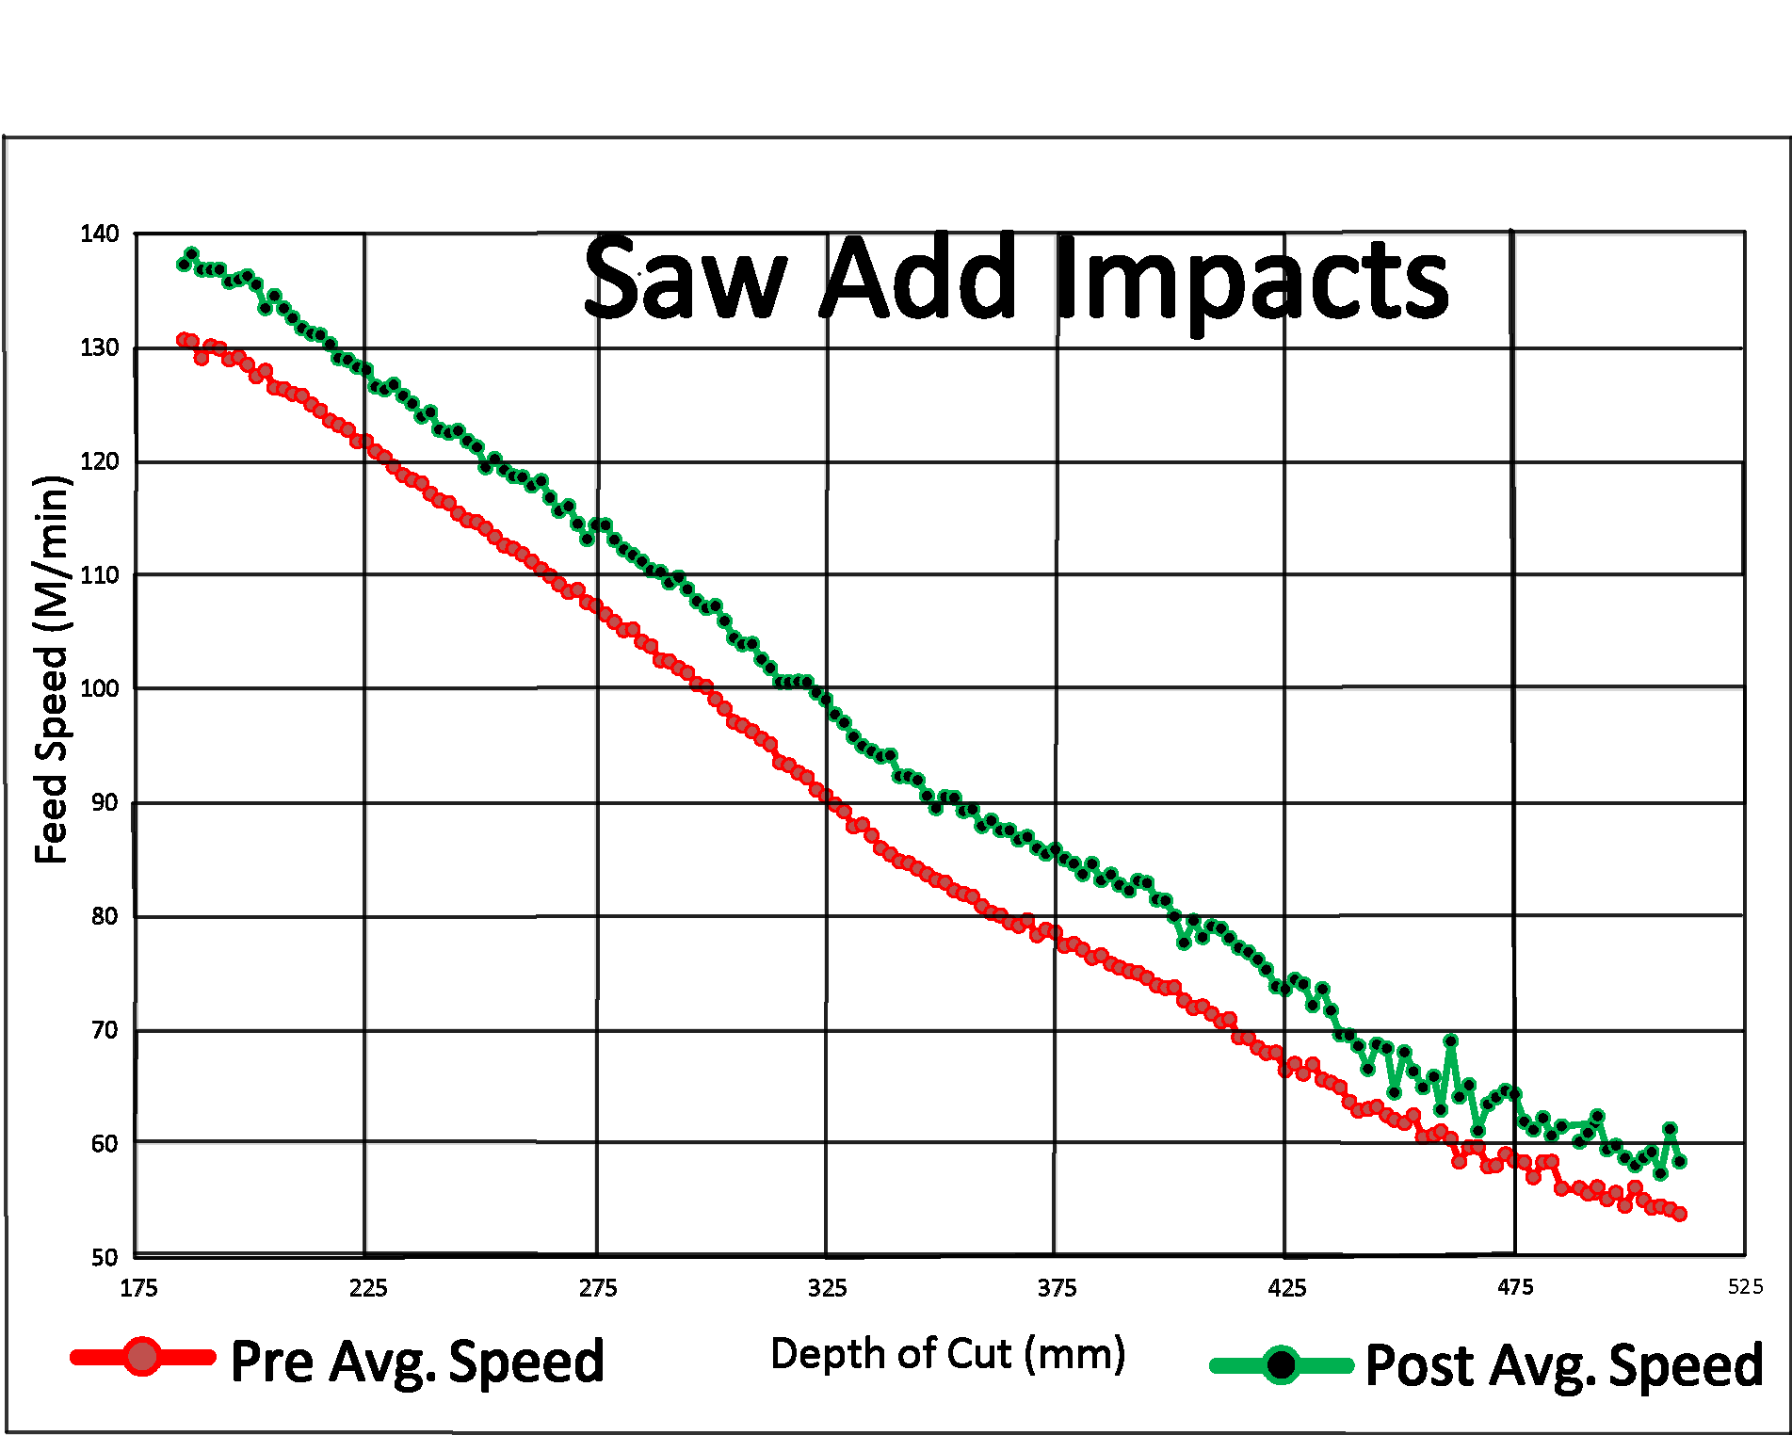
Month of data showing a nearly 8% average speed increase across all depths of cut
The red line is before Saw-ADD. The green line is after. Each dot on the lines represents 100’s of logs in each depth of cut
Each line-dot represents hundreds of logs.

Slide 3
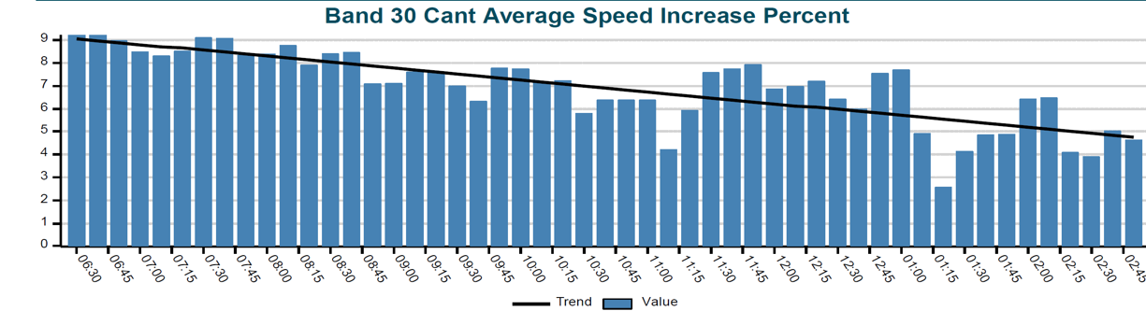




Chart shows bandsaws performance over a shift sawing frozen wood. Each bar is the 30 cant average percent speed increase over optimizer speeds. Notice the increase reduces as the saws get tired. Before Saw-ADD they would not have lasted an entire shift. If left on past lunch they would have wrecked. The speed is increased by the requested 10% upon entry and then reduced as necessary through the log. For nonfrozen wood the requested increase was as much as 15% and averaged over 10%.

Slide 4

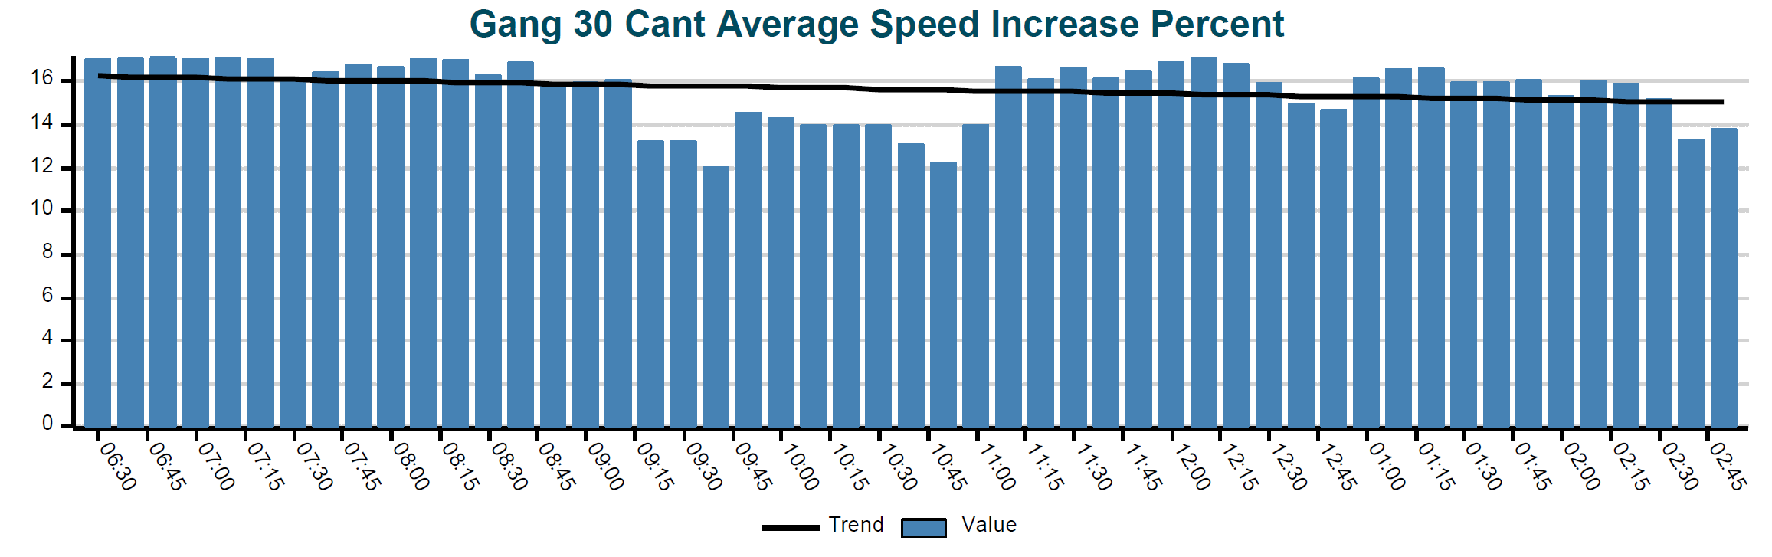
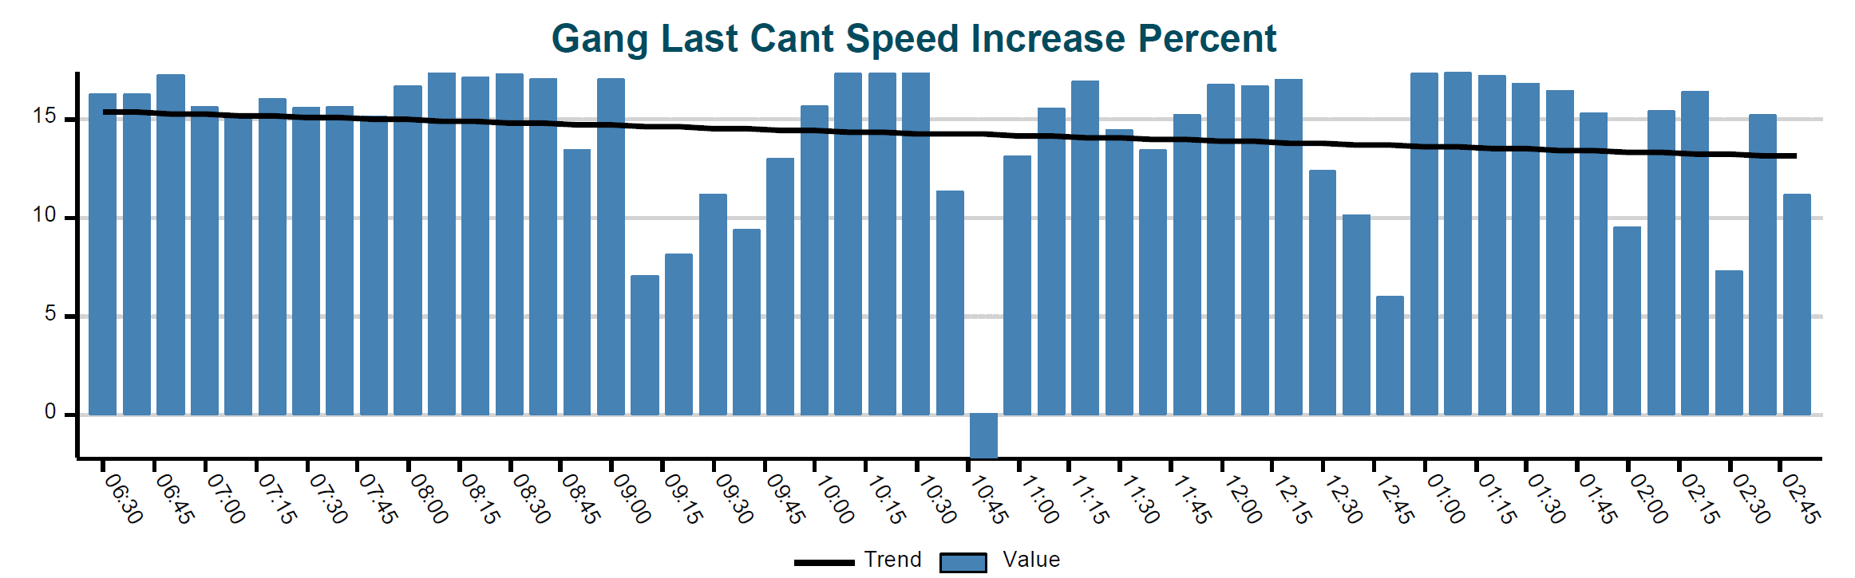





This upper graph shows the gang performance over an 8 hour shift on Douglas Fir. Each bar is the last 30 cant average percent speed increase over optimizer speeds. The black line shows the increased average is holding steady near 16% even without a saw change for that shift.
Each bar is the last single cant speed increase in the 15 min window, which can be a decrease if needed to save saws

Slide 5
The ability to increase production while decreasing deviation may be a misunderstood concept.
We will attempt to show visually in the following slide, using real captured data, how fast reaction to wood anomalies will increase average feed speeds over the conservative speeds that mills have been running.

Slide 6
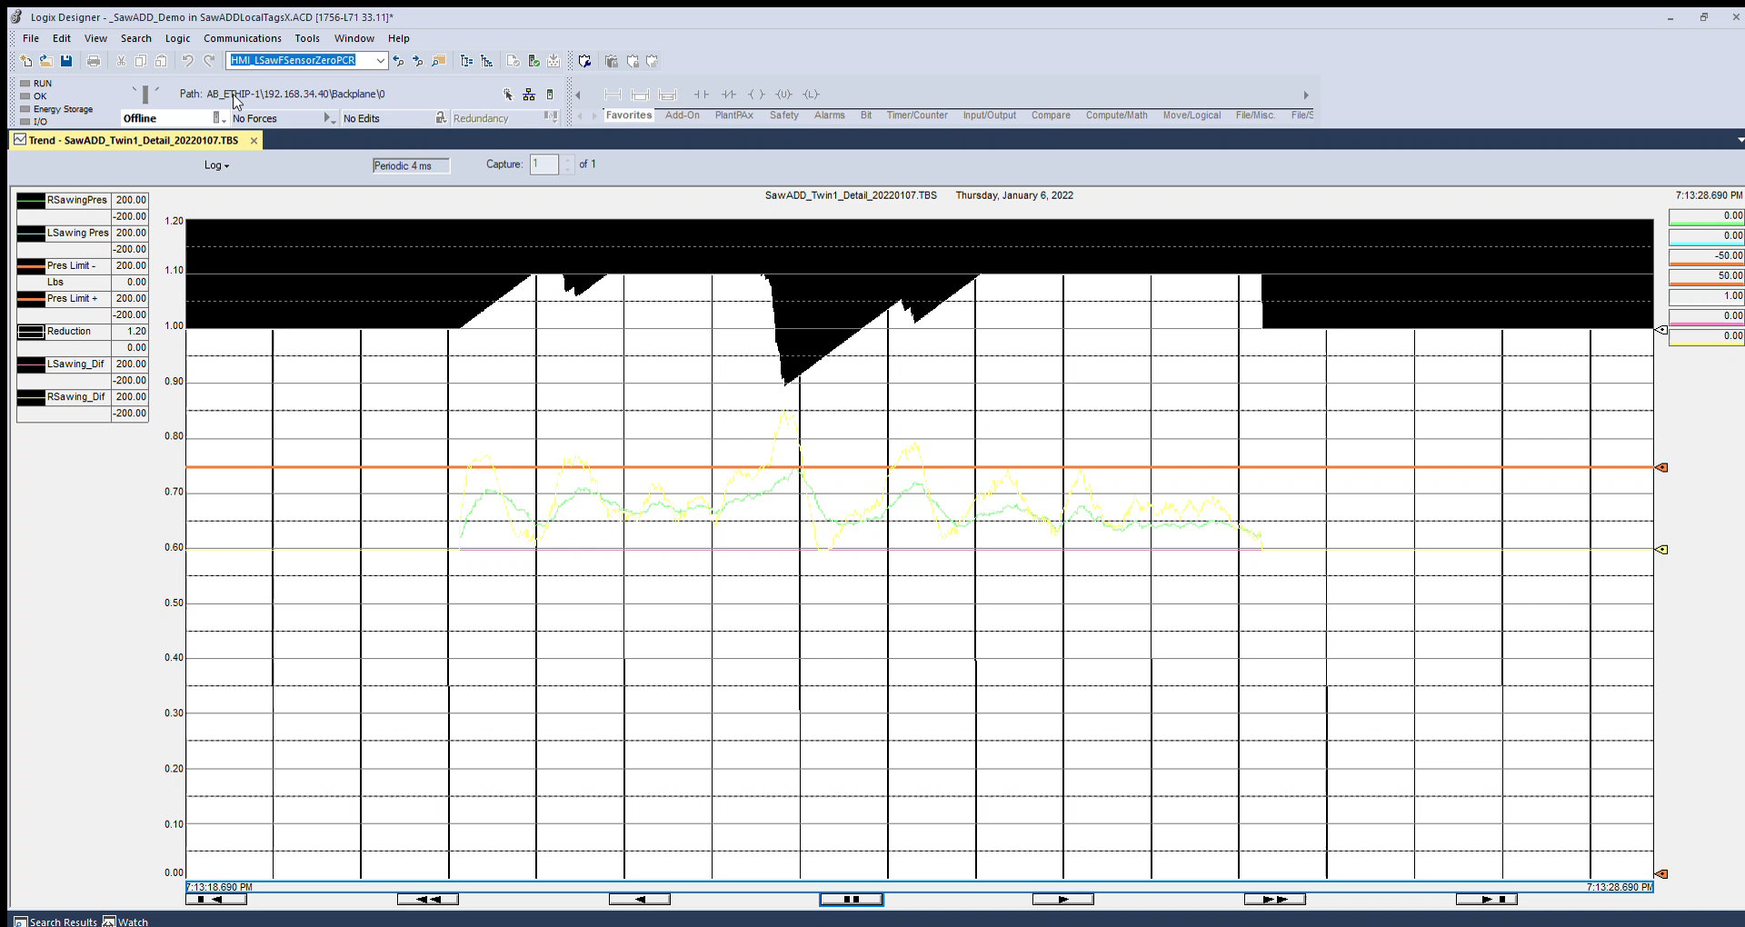

Slide 7
The Concept of Measuring Forces in Realtime on Round Saws is described next:

Slide 8
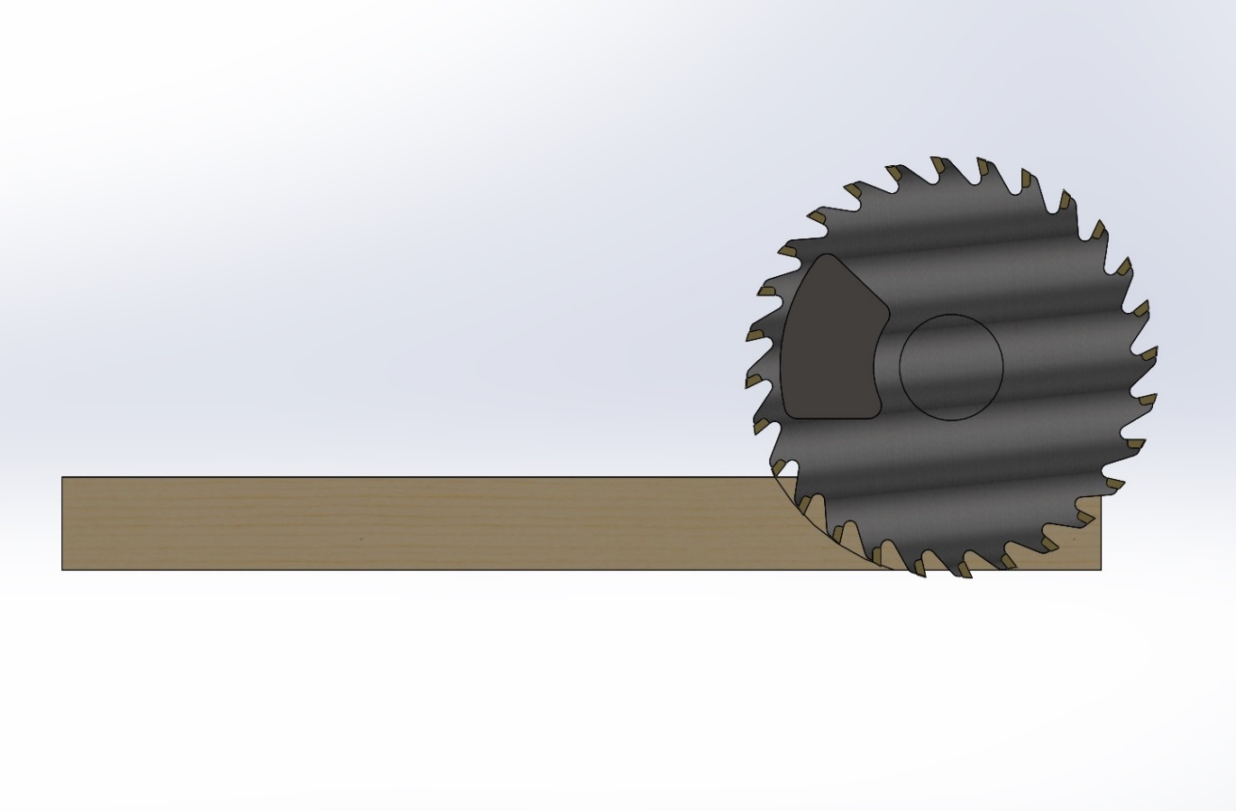

Equal & Opposite
Reaction Force
Radial Sawing Forces
Saw-ADD Measures the Sawing Force

Slide 9

Equal & Opposite
Reaction Force
Radial Friction Force
Saw-ADD Measures the Friction Force

Slide 10
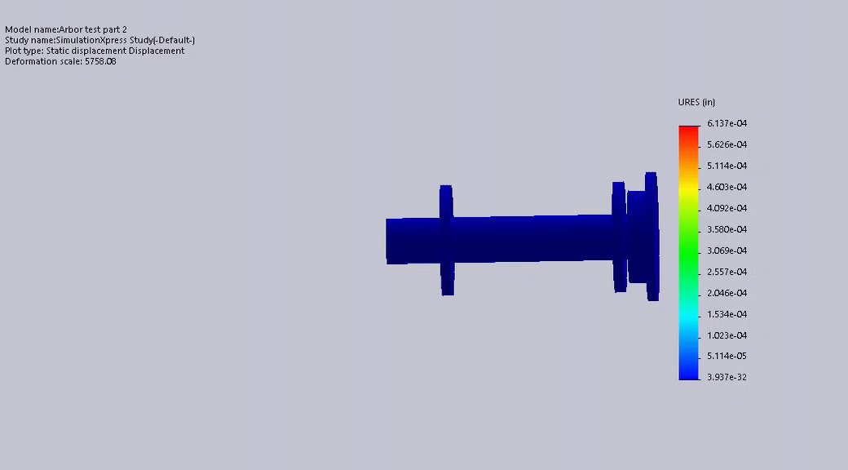

Actual movement is tenths of thousandths of an inch!
Saws
This is a simulation of radial forces on cartridge arbors caused by sawing and/or guide friction forces
(movement exaggerated).
Sensor placed here
Sensors on the arbor cartridge measure directional radial forces nearly a half second earlier than excess arbor current will occur.
Bearing
Bearing

Slide 11
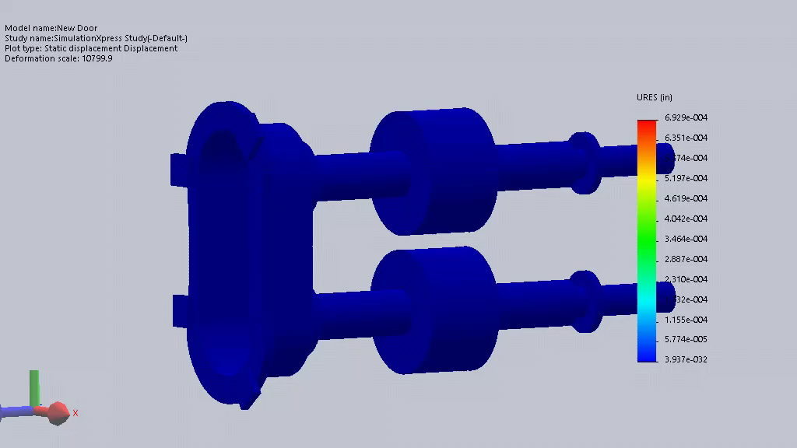

Saw ADD measures Radial Forces on Horizontal Arbors from outside the saw box. (movement exaggerated)
Sensor
tenths of thousandths of an inch!
Bearing
Bearing
Saws
Saw ADD closes the loop by automatically adjusting the feed speed during the cut.
This quick detection and subsequent action eliminates saw blade deviation which prevents sticking a cant or damaging saws
Saws
Bearing
Sensor
Bearing

Slide 12
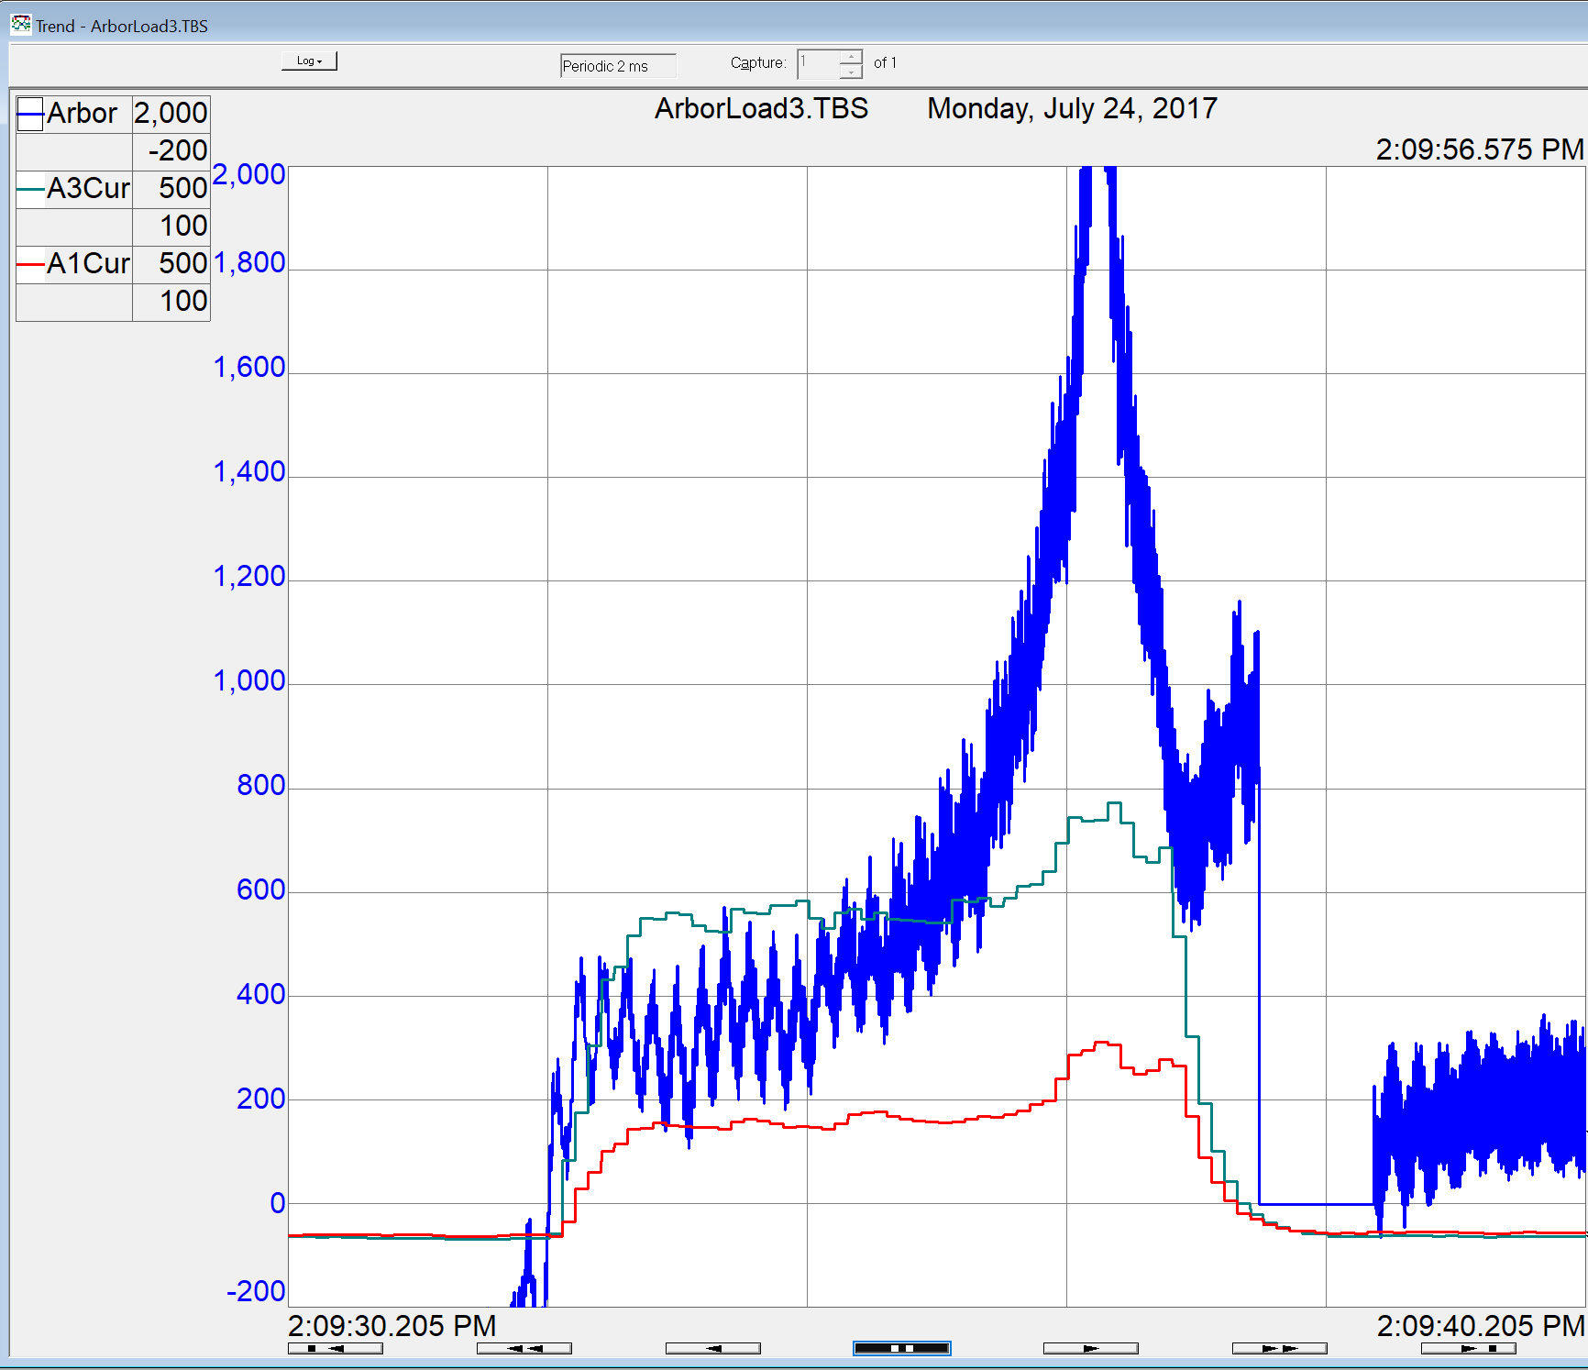

The blue trace is the sawing force on the bottom arbor of a Horizontal Curve Sawing Gang and green is the bottom arbor motor current which mimics the force, but the force shows a much higher sensitivity.

Slide 13
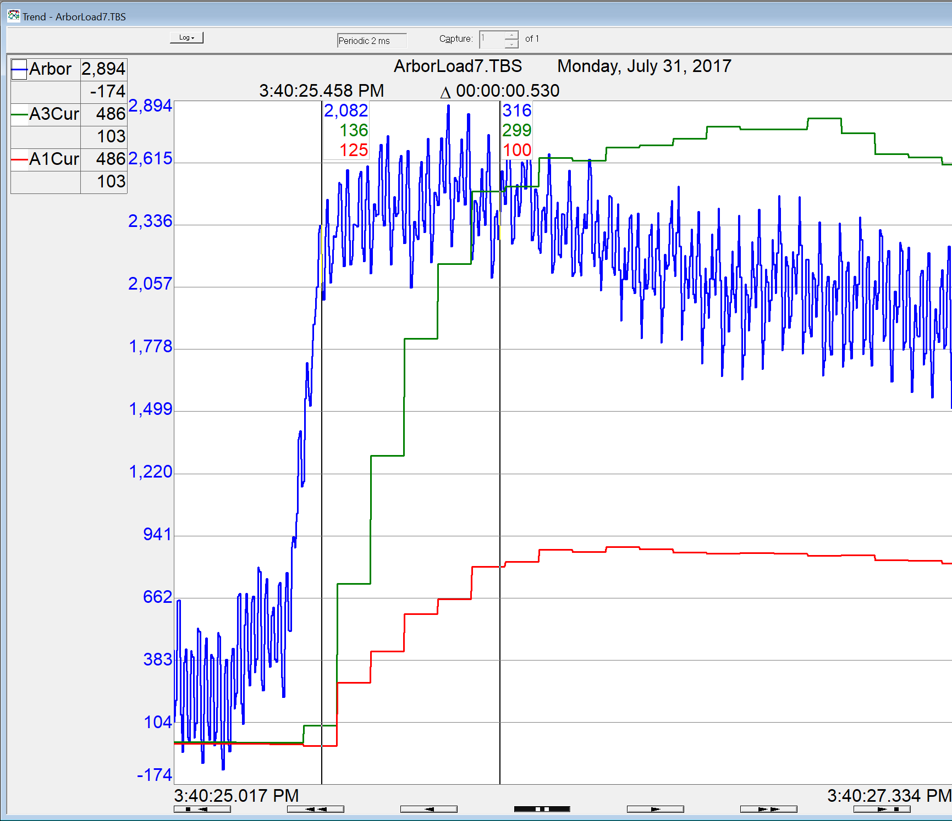
This zoomed in view of a trend on the HDA shows the force occurred more than a half second earlier than the arbor motor could react. Again force is blue and arbor motor amperage is green for the bottom arbor and red for the top arbor.

Slide 14
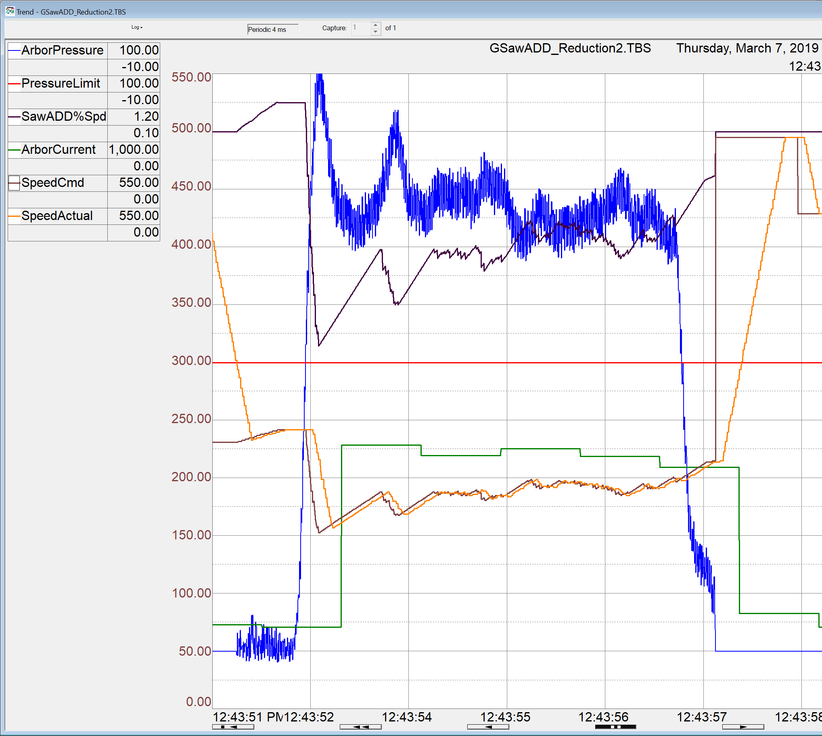
This trend on a VDAG shows Saw-ADD’s detection of excess forces on the leading arbor (blue) far sooner and with greater resolution than the arbor motor current (green)

Slide 15
Pay Back Calculator

